Slide 1

Error Analysis
Carrying out error
analysis
deeplearning.ai

Slide 2

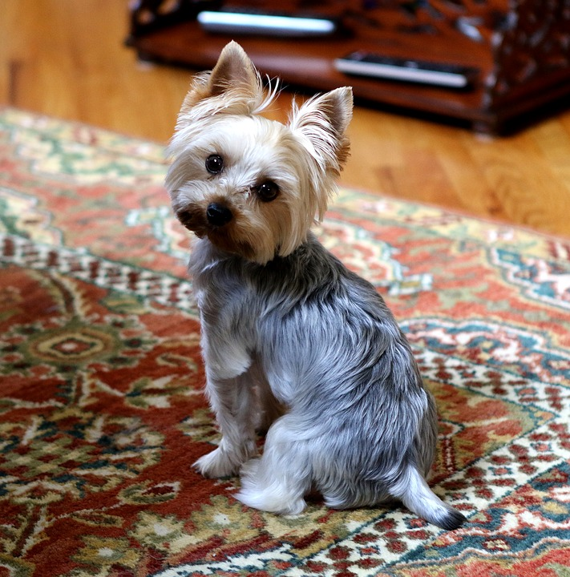
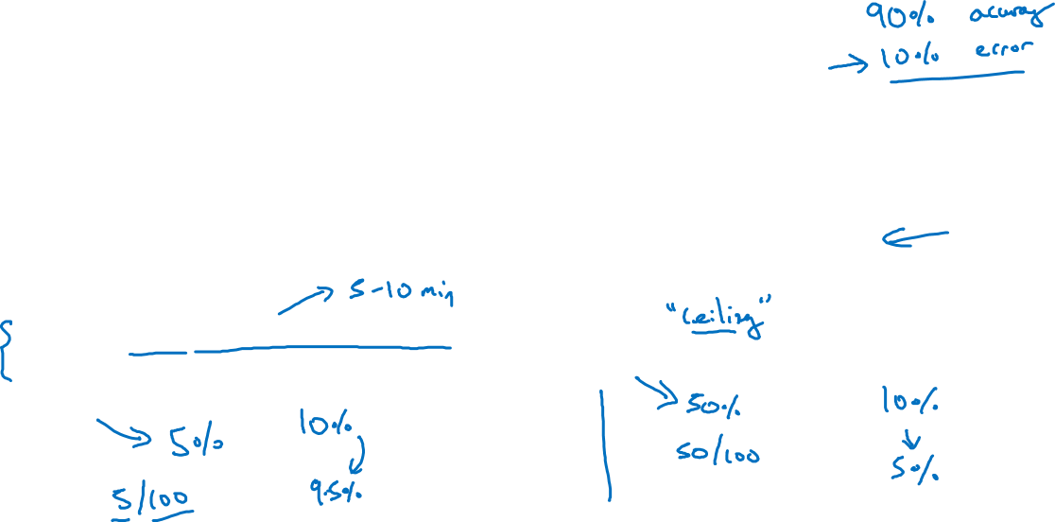
Look at dev examples to evaluate ideas
Should you try to make your cat classifier do better on dogs?
Error analysis:
Get ~100 mislabeled dev set examples.
Count up how many are dogs.

Slide 3
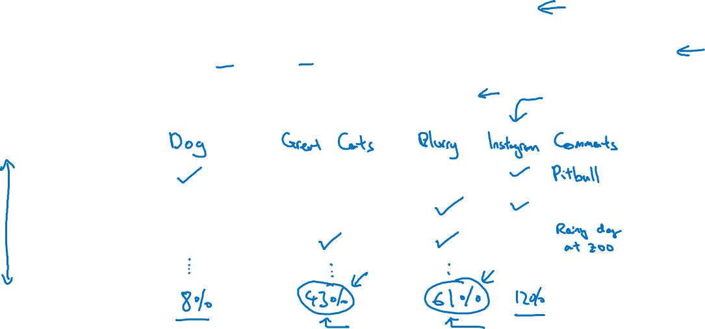
Evaluate multiple ideas in parallel
Ideas for cat detection:
Fix pictures of dogs being recognized as cats
Fix great cats (lions, panthers, etc..) being misrecognized
Improve performance on blurry images
Image
1
2
3
% of total
.
.
.

Slide 4
Error Analysis
Cleaning up
Incorrectly labeled data
deeplearning.ai

Slide 5
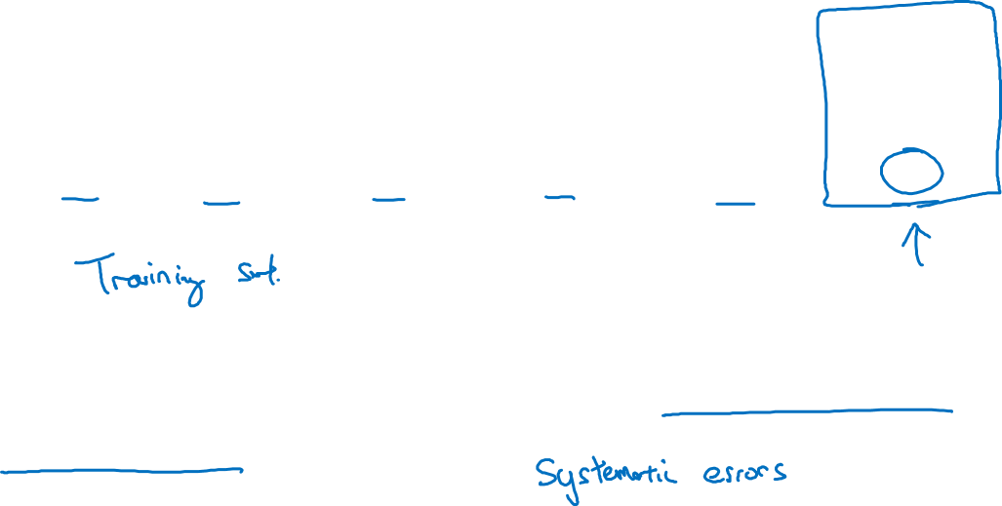
Incorrectly labeled examples
x
y
1
0
1
1
0
1
1
DL algorithms are quite robust to random errors in the
training set.

Slide 6
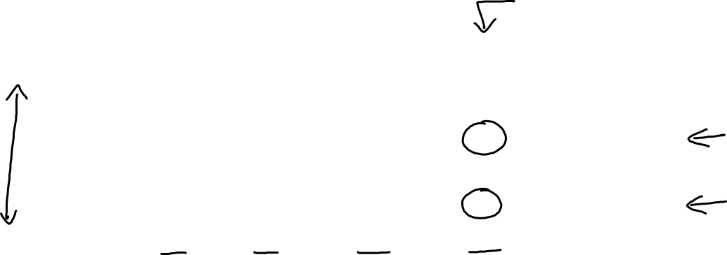
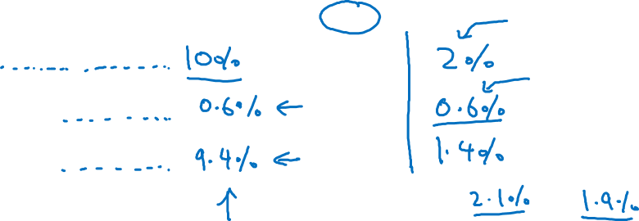
Error analysis
Image | Dog | Great Cat | Blurry | Incorrectly labeled | Comments
…
98 |  |  |  | ✓ | Labeler missed cat in background
99 |  | ✓
100 |  |  |  | ✓ | Drawing of a cat; Not a real cat.
% of total | 8% | 43% | 61% | 6%
Overall dev set error
Errors due incorrect labels
Errors due to other causes
Goal of dev set is to help you select between two classifiers A & B.

Slide 7

Correcting incorrect dev/test set examples
Apply same process to your dev and test sets to make sure they continue to come from the same distribution
Consider examining examples your algorithm got right as well as ones it got wrong.
Train and dev/test data may now come from slightly different distributions.

Slide 8
Error Analysis
Build your first system
quickly, then iterate
deeplearning.ai

Slide 9
Speech recognition example
Noisy background
Café noise
Car noise
Accented speech
Far from microphone
Young children’s speech
Stuttering
…
Set up dev/test set and metric
Build initial system quickly
Use Bias/Variance analysis & Error analysis to prioritize next steps.
Guideline:
Build your first system quickly, then iterate

Slide 10
Build system quickly, then iterate (Supplemental Notes)
Depending on the area of application, the guideline below will help you prioritize when you build your system.
Guideline
1. Set up development/ test set and metrics
Set up a target
2. Build an initial system quickly
Train training set quickly: Fit the parameters
Development set: Tune the parameters
Test set: Assess the performance
3. Use Bias/Variance analysis & Error analysis to prioritize next steps

Slide 11
Mismatched training and dev/test data
Training and testing on different distributions
deeplearning.ai

Slide 12
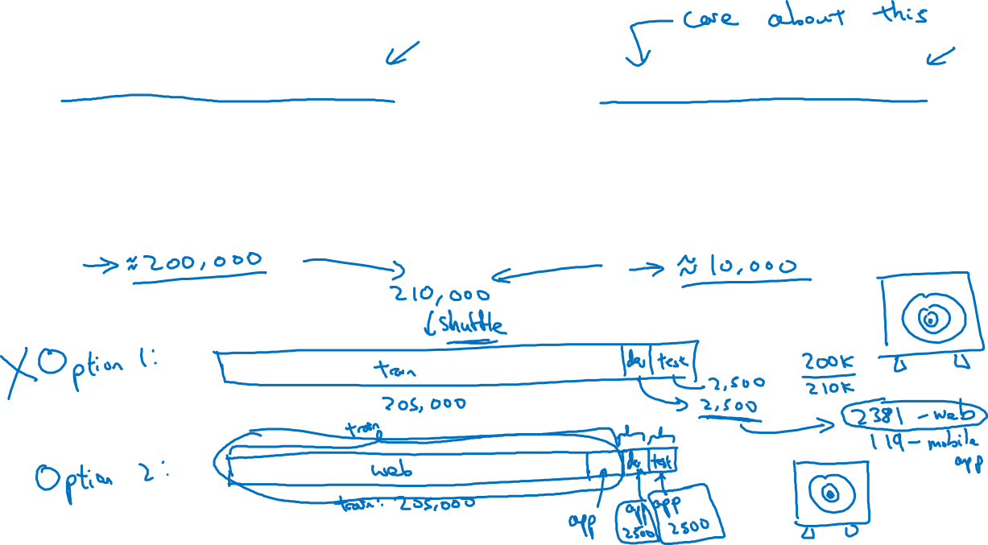
Cat app example
Data from webpages
Data from mobile app

Slide 13
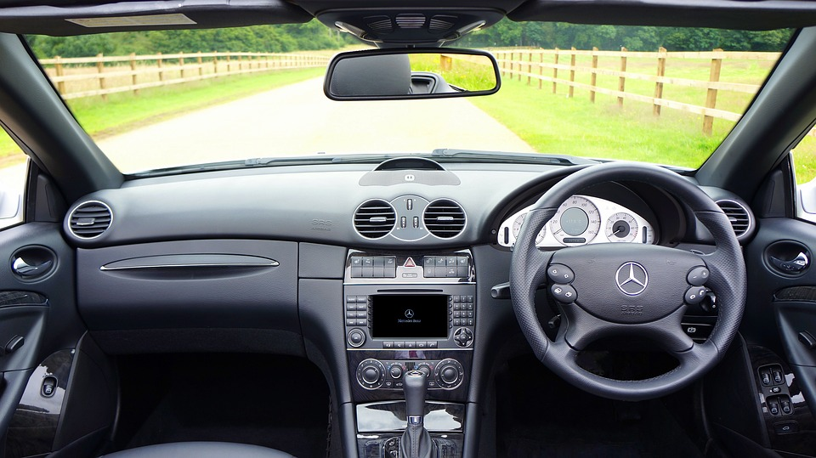
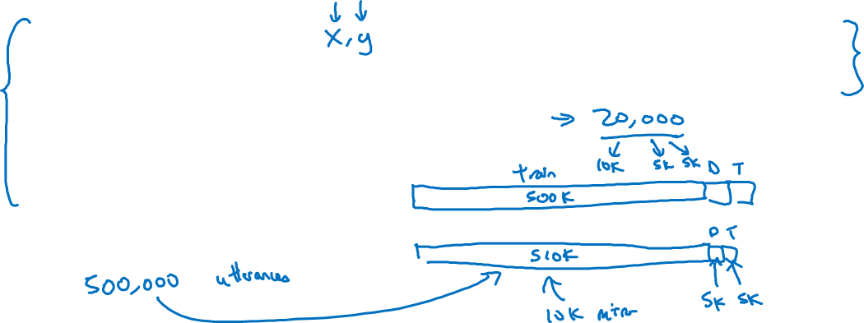
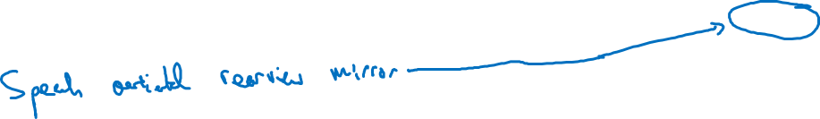
Speech recognition example
Training
Dev/test
Purchased data
Speech activated rearview mirror
Smart speaker control
Voice keyboard
…

Slide 14
Training and testing on different distributions (Supplemental Notes)
…
The problem is that you have a different distribution:
1- small data set from pictures uploaded by users. This distribution is important for the mobile app.
2- bigger data set from the web.
The guideline used is that you have to choose a development set and test set to reflect data you expect to get in the future and consider important to do well.
…
See more in Supplemental Notes.

Slide 15
Mismatched training and dev/test data
Bias and Variance with
mismatched data
distributions
deeplearning.ai

Slide 16
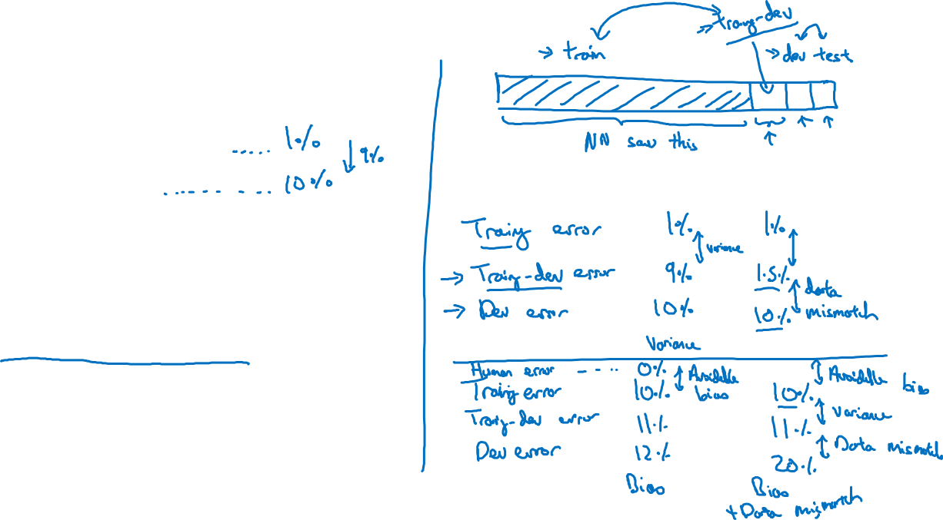
Cat classifier example
Assume humans get ≈ 0% error.
Training error
Dev error
Training-dev set: Same distribution as training set, but not used for training

Slide 17
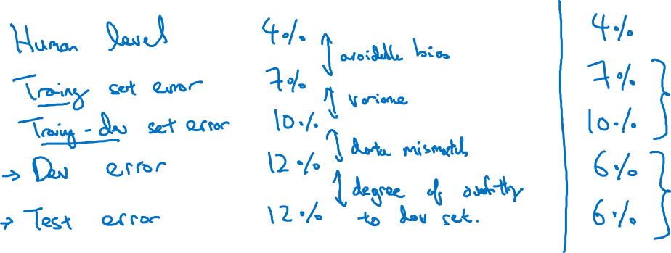
Bias/variance on mismatched training and dev/test sets

Slide 18
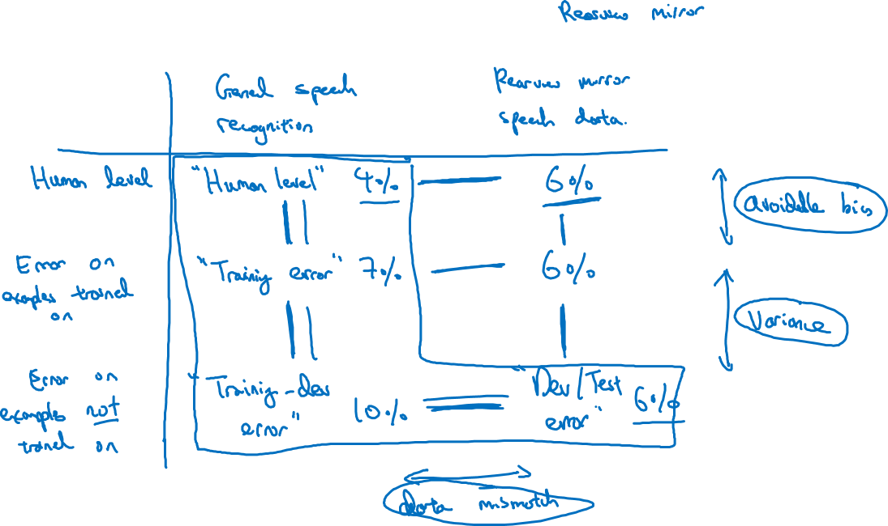
More general formulation

Slide 19
Introduction to Neural Networks
About this Course
deeplearning.ai

Slide 20
Courses in this Specialization
Neural Networks and Deep Learning
Improving Deep Neural Networks: Hyperparameter tuning, Regularization and Optimization
Structuring your Machine Learning project
Convolutional Neural Networks
Natural Language Processing: Building sequence models
Notes:
https://pixabay.com/en/cat-pets-cat-s-eyes-mieze-dear-451377/

Slide 21
Outline of this Course
Week 1: Introduction
Week 2: Basics of Neural Network programming
Week 3: One hidden layer Neural Networks
Week 4: Deep Neural Networks

